Slide 1
CN:CST31209 : Deep Learning and Big Data Intelligence
JING WEN
Spring 2021
Lecture 6:Training Neural Networks II
Notes:
Where to put block multi-vector algorithms?
Percentage of Future Work
Diagram

Slide 2
Last time:
Activation Functions
Data Preprocessing
Weight Initialization
Babysitting the Learning process
Hyperparameter optimization

Slide 3
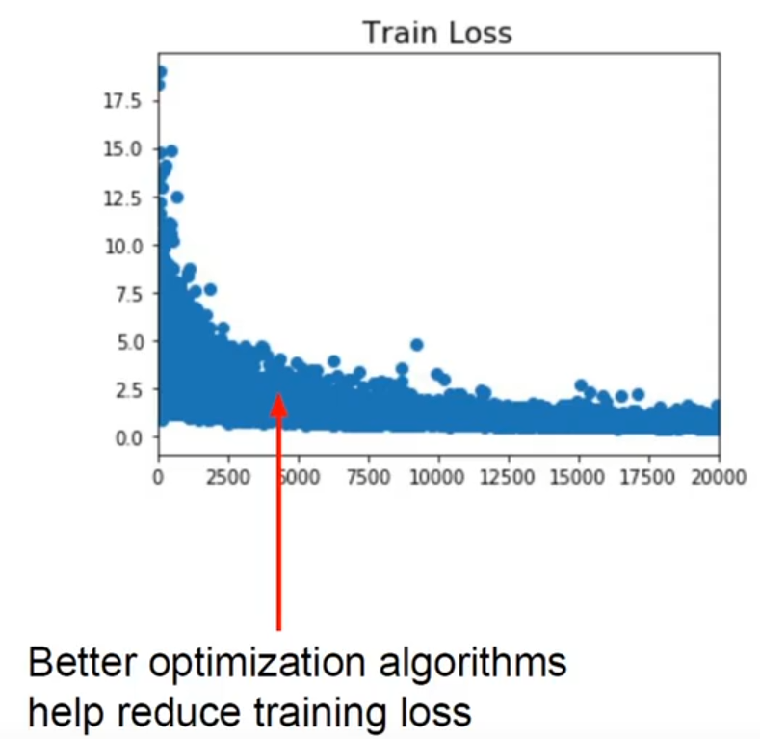
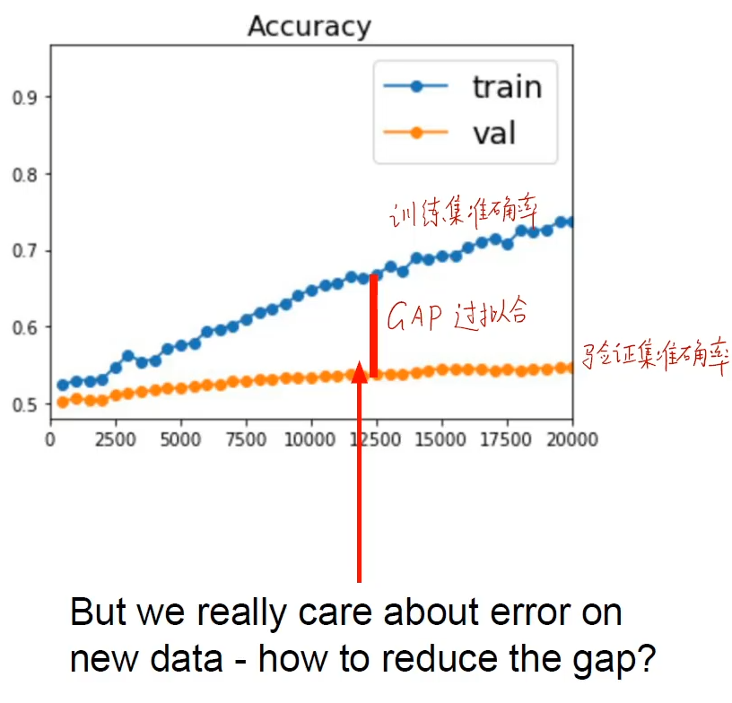

Slide 4
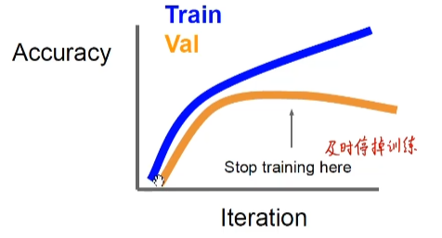
Early stop

Slide 5
This lecture: wrap up of training deep networks
Model Ensembles
Dropout
Dropconnect
Normalization
Regularization

Slide 6
Ensemble Learning
Ensemble: A model built from many simpler models.
Two main methods:
Bagging:
Boosting:

Slide 7
Ensemble Learning
Ensemble: A model built from many simpler models
Two main methods:
Bagging: (Bootstrap AGgregation): Train base models on bootstrap samples of the data. Take majority vote for classification tasks, or average output for regression.
Boosting:
Notes:
在不同的训练集上训练多个模型
如果训练集稍微有所改变就会导致分类器性能比较大大变化那么我们可以采用bagging

Slide 8
Ensemble Learning
Ensemble: A model built from many simpler models
Two main methods:
Bagging: (Bootstrap AGgregation): Train base models on bootstrap samples of the data. Take majority vote for classification tasks, or average output for regression.
Boosting: Learners are ordered: Each learner tries to reduce error (residual) on “hard” examples (those misclassified by earlier learners).
Notes:
训练集不变，只是训练集中每个样例在分类器中的权重发生变化。

Slide 9
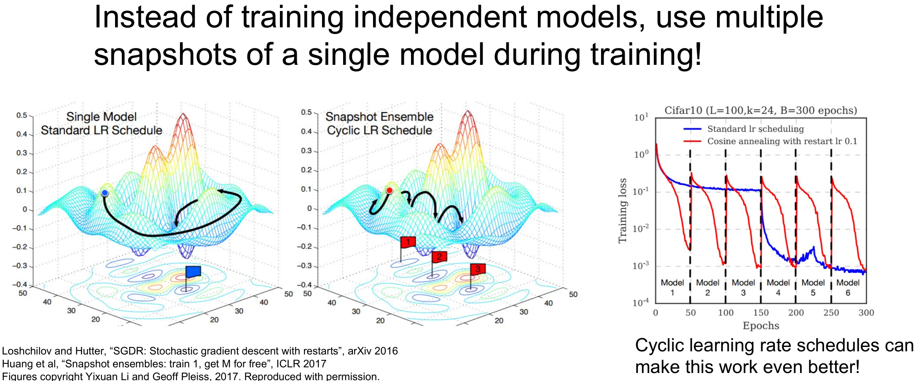
Bagging on image classification tasks
Notes:
学习率周期性变化，产生不同模型集成

Slide 10
Bagging on image classification tasks
Enjoy 2% extra accuracy

Slide 11
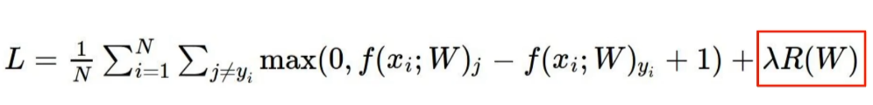
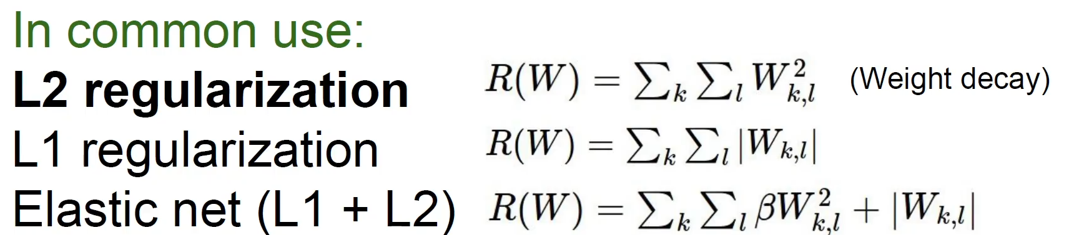
Regularization:add term to loss

Slide 12
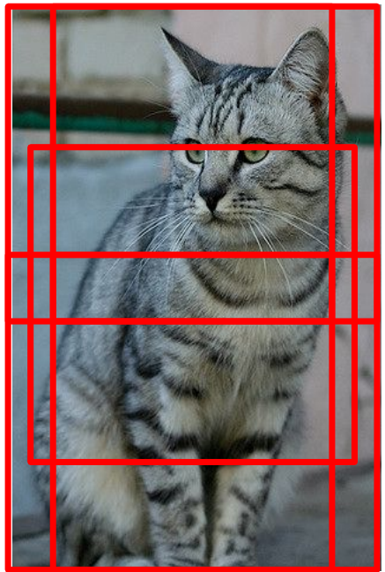
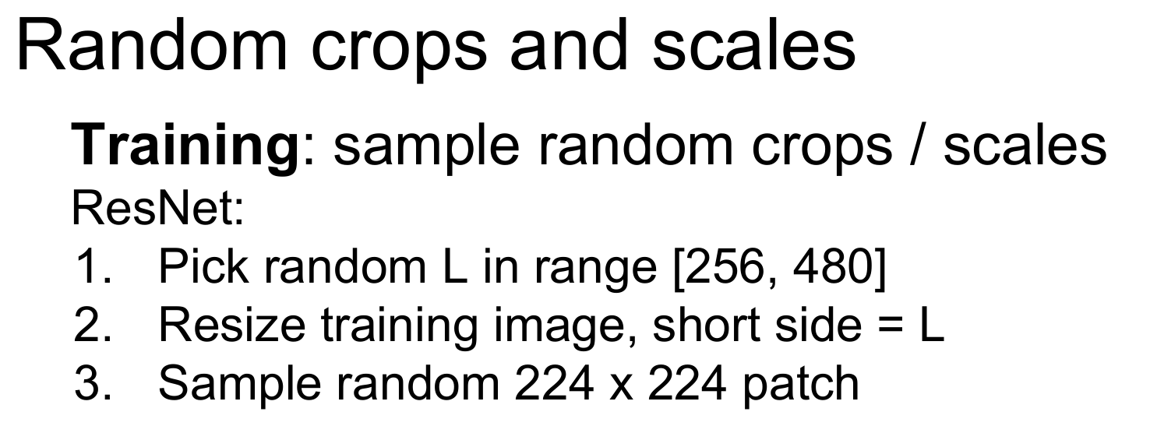
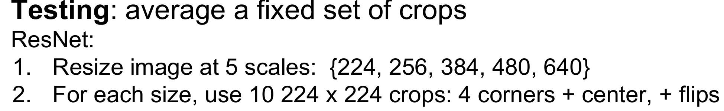
Data augmentation

Slide 13
Regularization (dropout)

Slide 14
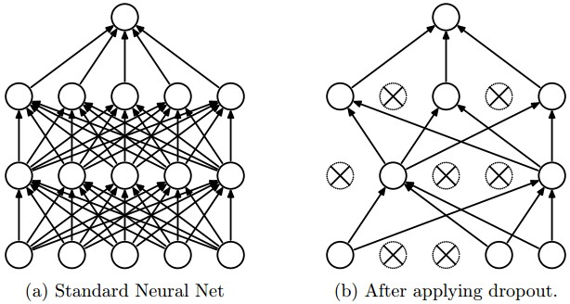
Regularization by Dropout
“randomly set some neurons to zero in the forward pass”
each neuro has p% to dropout
0.5 is common
[Srivastava et al., Dropout: A Simple Way to Prevent Neural Networks from Overfitting
2014]

Slide 15
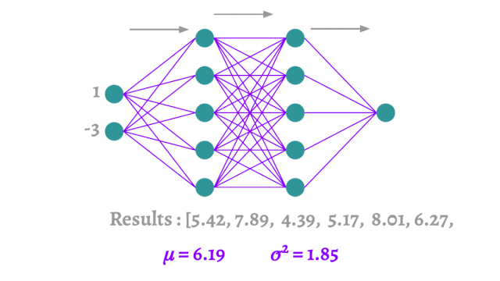
Regularization (dropout)

Slide 16
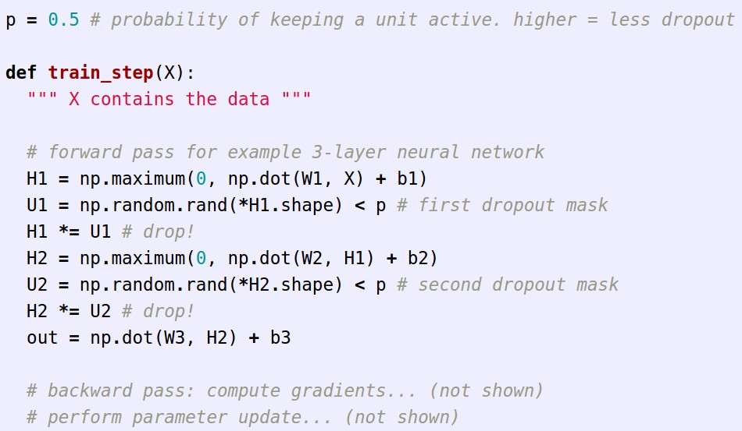
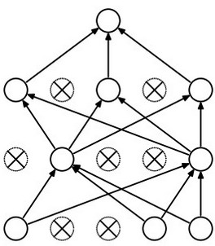
Regularization (dropout)
Example forward pass with a 3-layer network using dropout

Slide 17
Regularization (dropout)
Waaaait a second…
How could this possibly be a good idea?

Slide 18
Waaaait a second…
How could this possibly be a good idea?
Forces the network to have a redundant representation.
has an ear
X
has a tail
is furry
X
cat
score
has claws
mischievous
look
X
Notes:
打破了神经元间的联合适应性。每个特征变得强大

Slide 19
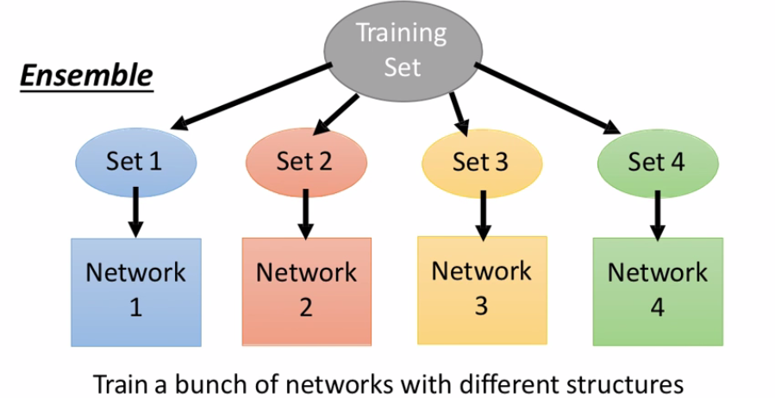
Regularization (dropout)
Waaaait a second…
How could this possibly be a good idea?
Another interpretation:
Dropout is training a large ensemble of models (that share parameters).
Each binary mask is one model, gets trained on only ~one datapoint.

Slide 20
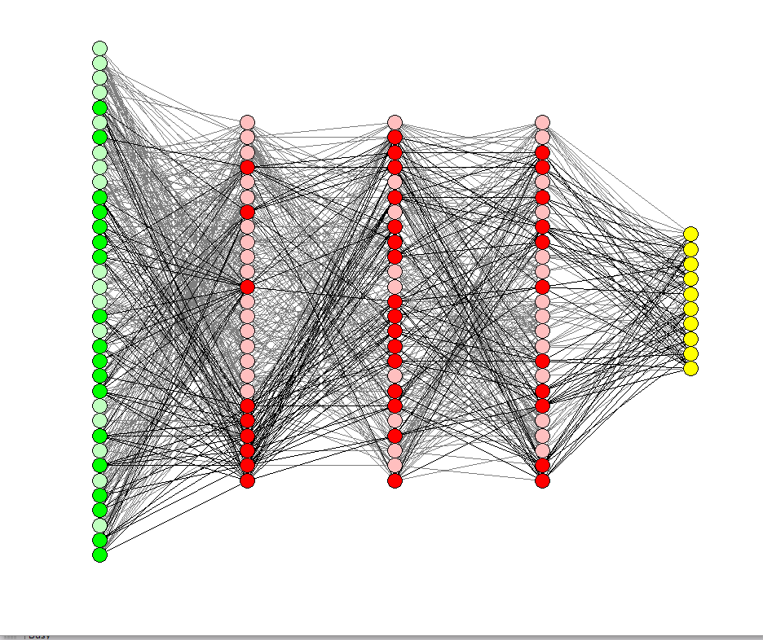
Dropout: N Srivastava, G Hinton, A Krizhevsky,a simple way to prevent neural networks from Journal of Machine Learning Research 15 (2014) 1929-1958

Slide 21
At test time….
Can in fact do this with a single forward pass! (approximately)
Leave all input neurons turned on (no dropout).
(this can be shown to be an approximation to evaluating the whole ensemble)

Slide 22
At test time….
Can in fact do this with a single forward pass! (approximately)
Leave all input neurons turned on (no dropout).
Q: Suppose that with all inputs present at test time the output of this neuron is x.
What would its output be during training time, in expectation? (e.g. if p = 0.5)

Slide 23
At test time….
Can in fact do this with a single forward pass! (approximately)
Leave all input neurons turned on (no dropout).
during test: a = w0*x + w1*y
during train:
E[a] = ¼ * (w0*0 + w1*0
w0*0 + w1*y
w0*x + w1*0
w0*x + w1*y)
= ¼ * (2 w0*x + 2 w1*y)
= ½ * (w0*x + w1*y)
a
w0
w1
x
y

Slide 24
At test time….
Can in fact do this with a single forward pass! (approximately)
Leave all input neurons turned on (no dropout).
during test: a = w0*x + w1*y
during train:
E[a] = ¼ * (w0*0 + w1*0
w0*0 + w1*y
w0*x + w1*0
w0*x + w1*y)
= ¼ * (2 w0*x + 2 w1*y)
= ½ * (w0*x + w1*y)
With p=0.5, using all inputs in the forward pass would inflate the activations by 2x from what the network was “used to” during training!
=> Have to compensate by scaling the activations back down by ½
a
w0
w1
x
y
p

Slide 25
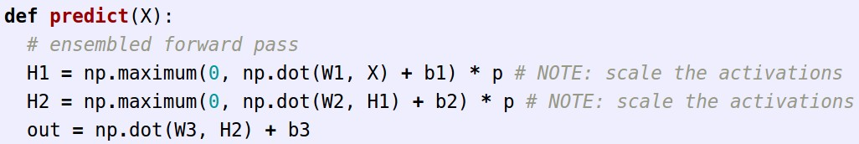
We can do something approximate analytically
At test time all neurons are active always
=> We must scale the activations so that for each neuron:
output at test time = expected output at training time

Slide 26
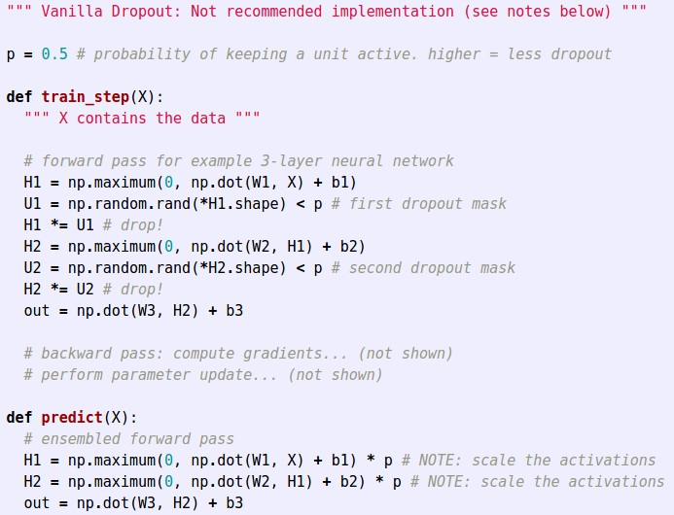
Dropout Summary
drop in forward pass
scale at test time

Slide 27
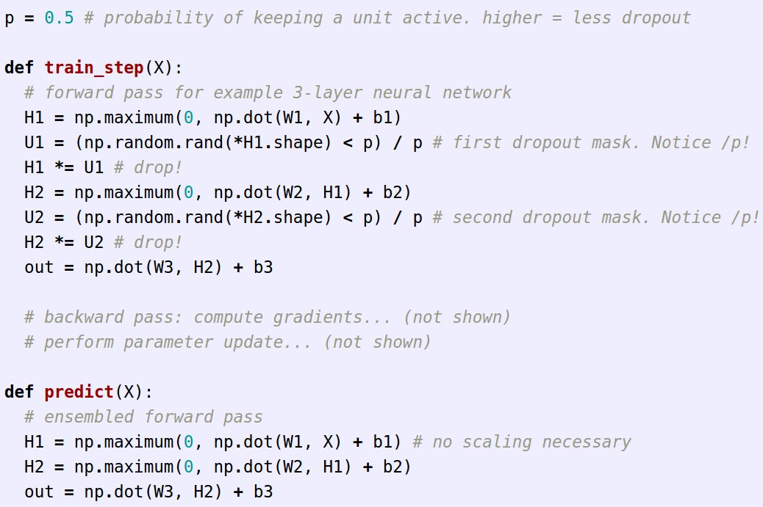
More common: “Inverted dropout”
test time is unchanged!

Slide 28
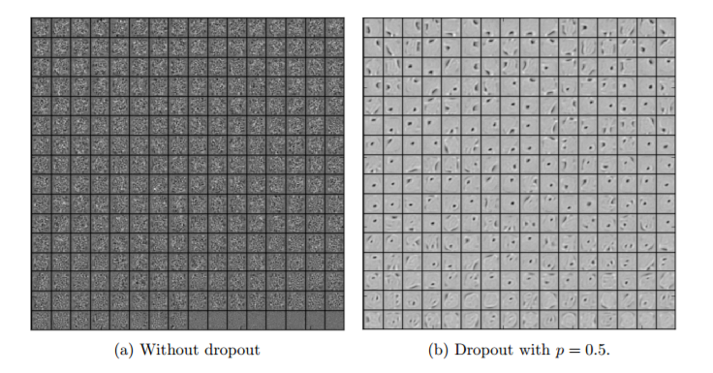
Regularization (dropout)
[Srivastava et al., Dropout: A Simple Way to Prevent Neural Networks from Overfitting
2014]

Slide 29
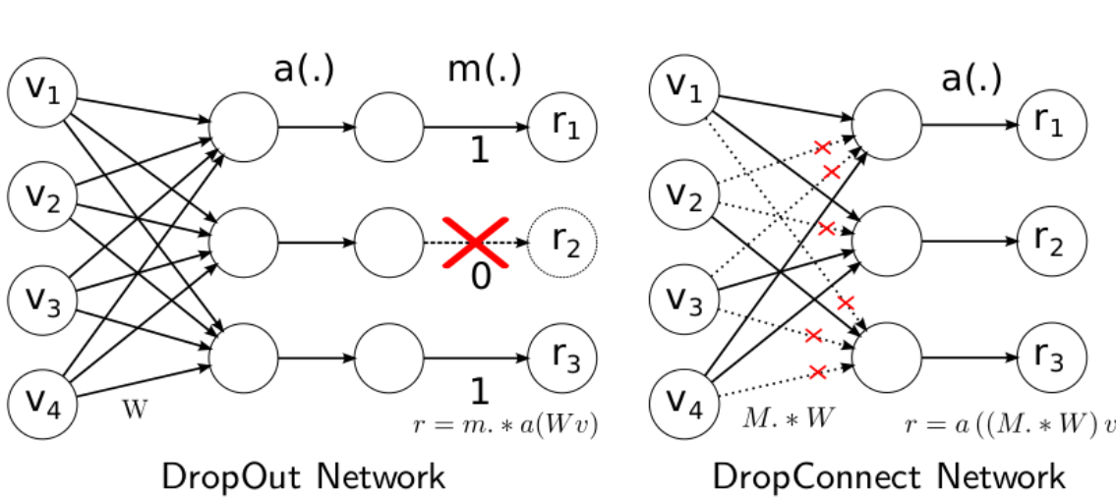
Regularization (drop connect)

Slide 30
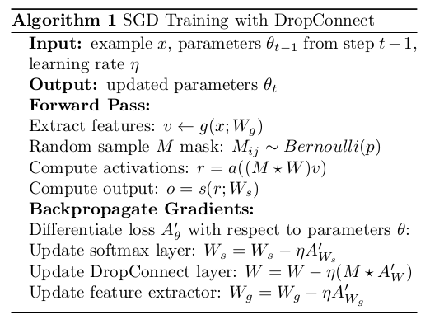
Regularization (drop connect)

Slide 31
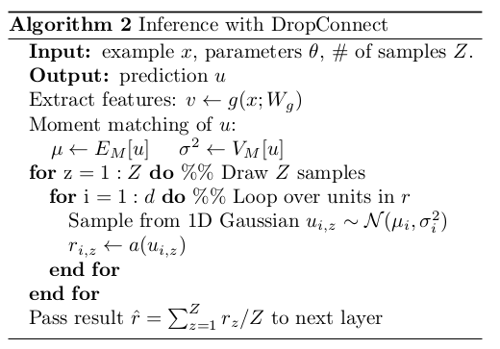
Regularization (drop connect)

Slide 32
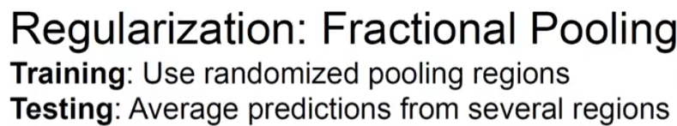
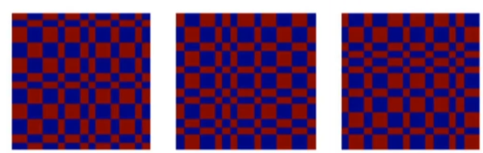
Notes:
实现池化的时候没有用确定大小的poolsize，而是随机化的

Slide 33
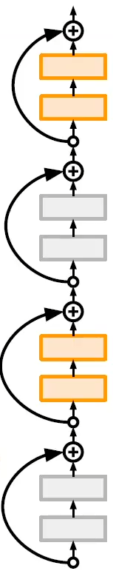
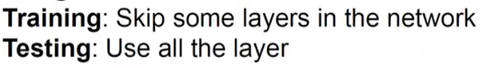

Slide 34
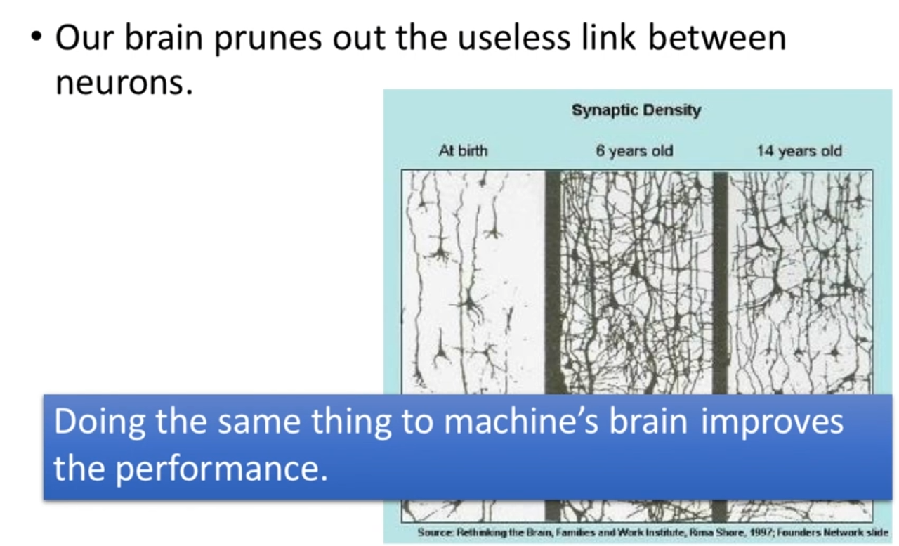
Weight decay

Slide 35
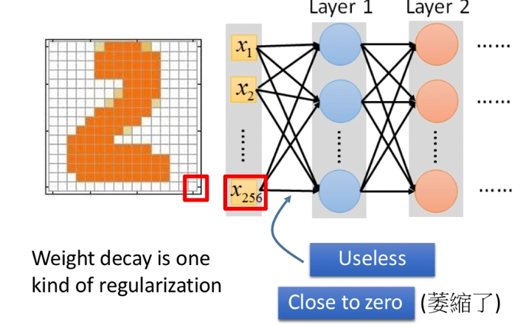
Weight decay

Slide 36
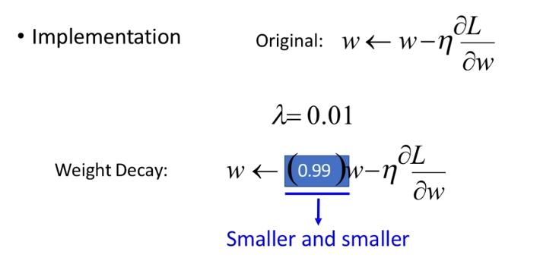
Weight decay

Slide 37
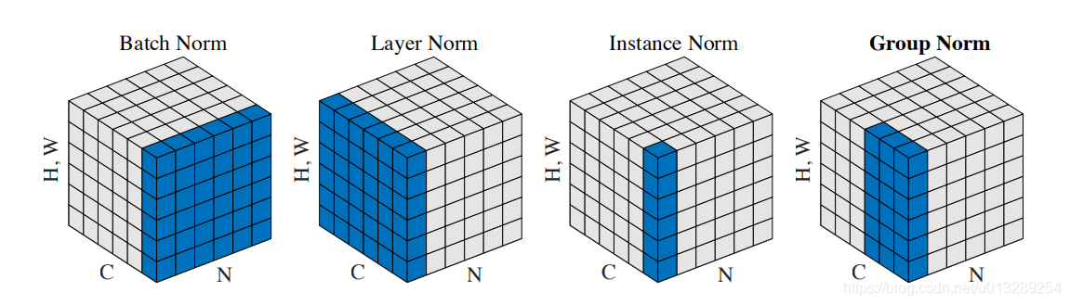
Normalization
BN：Batch Normalization
LN: Layer Normalization
IN: Instance Normalization
GN: Group Normalization
SN: Switchable Normalization
Normalization

Slide 38
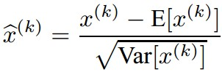
Batch Normalization
Batch Normalization
[Ioffe and Szegedy, 2015]
“you want unit gaussian activations? just make them so.”
consider a batch of activations at some layer. To make each dimension unit gaussian, apply:
this is a vanilla differentiable function...

Slide 39
Batch Normalization
Batch Normalization
[Ioffe and Szegedy, 2015]
“you want unit gaussian activations?
just make them so.”
1. compute the empirical mean and variance independently for each dimension.
X
N
2. Normalize
D
Per channel mean :shape is D
Normalized x:shape is n*D

Slide 40
Batch Normalization
Batch Normalization
[Ioffe and Szegedy, 2015]
FC
Usually inserted after Fully Connected / (or Convolutional, as we’ll see soon) layers, and before nonlinearity.
BN
tanh
FC
BN
Problem: do we necessarily want a unit gaussian input to a tanh layer?
tanh
...

Slide 41
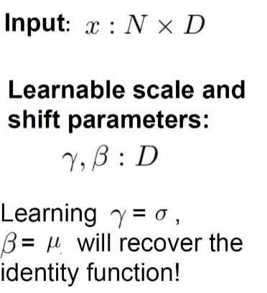
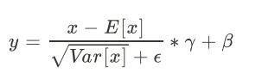
Batch Normalization
Batch Normalization
[Ioffe and Szegedy, 2015]
Train….
Normalize:
And then allow the network to squash
the range if it wants to:
若学习得到以上结果，相当于没有BN

Slide 42
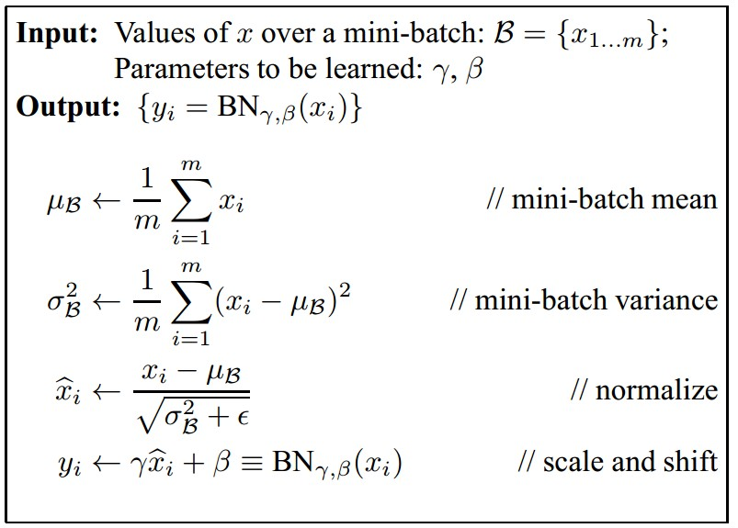
Batch Normalization
Batch Normalization
[Ioffe and Szegedy, 2015]
Improves gradient flow through the network
Allows higher learning rates
Reduces the strong dependence on initialization
Acts as a form of regularization in a funny way, and slightly reduces the need for dropout, maybe

Slide 43
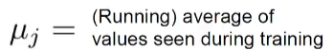
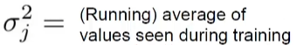
At test…
Notes:
每次输入一个样本

Slide 44
Batch Normalization
Batch Normalization
[Ioffe and Szegedy, 2015]
Note: at test time BatchNorm layer functions differently:
The mean/std are not computed based on the batch. Instead, a single fixed empirical mean of activations during training is used.
(e.g. can be estimated during training with running averages)

Slide 45
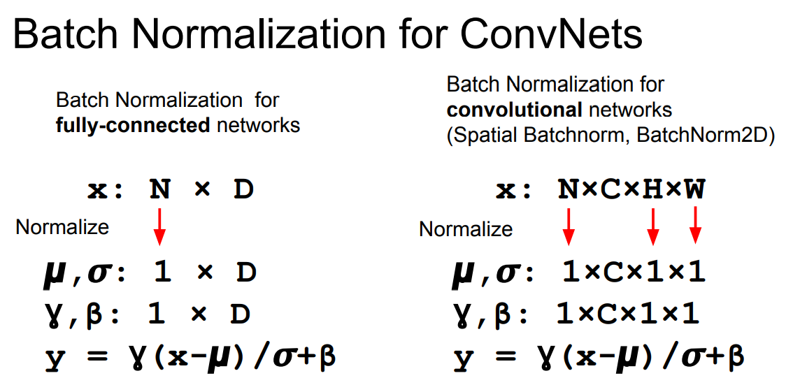
Normalization

Slide 46
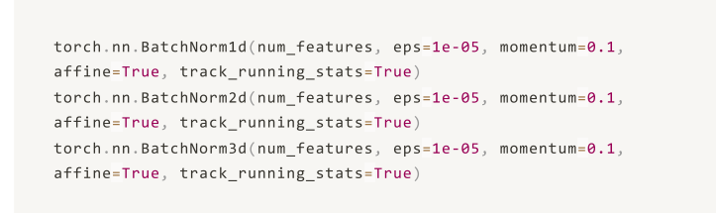
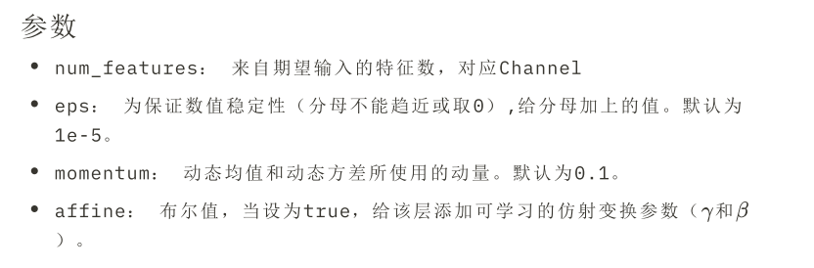

Slide 47
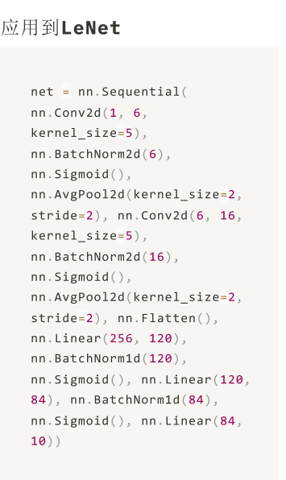
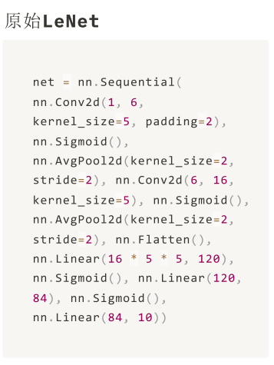

Slide 48
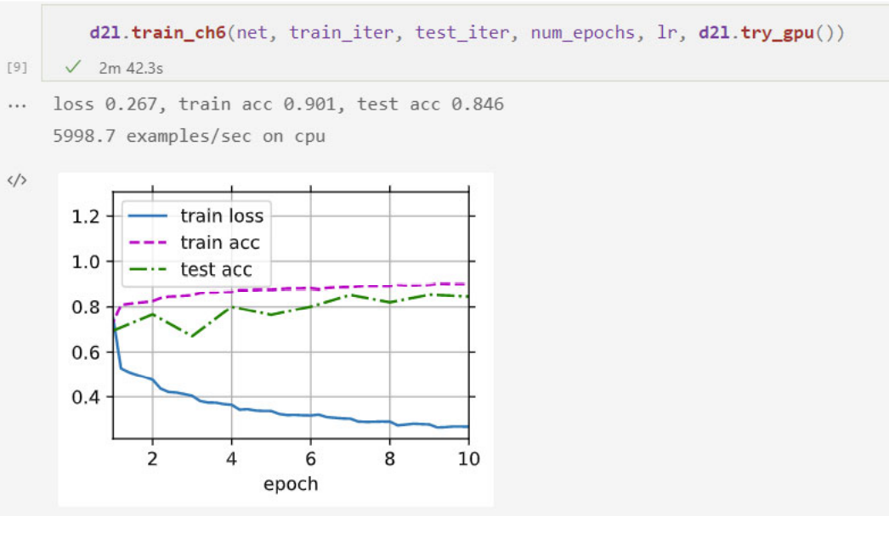
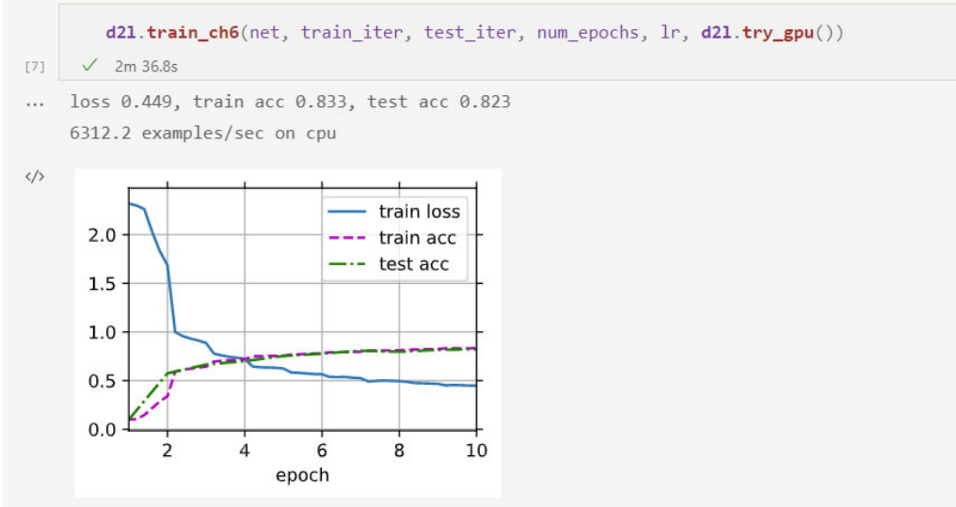

Slide 49
BN放在激活层之前，卷积层之前或之后
不与dropout混合使用
对batchsize大小比较敏感
加快收敛，改善梯度
对初始化不敏感
RNN不使用
训练测试时不一样
Notes:
使用大学习率也不怕

Slide 50
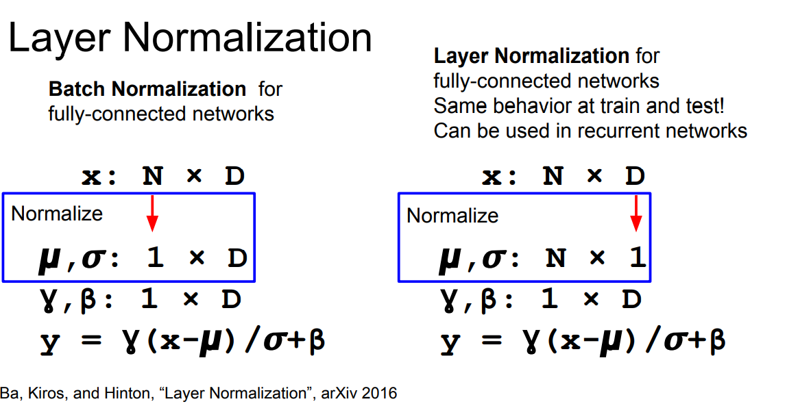
Normalization

Slide 51
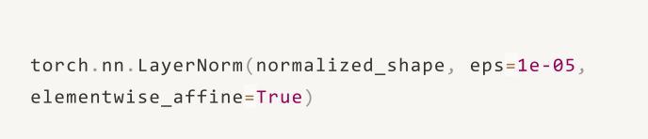
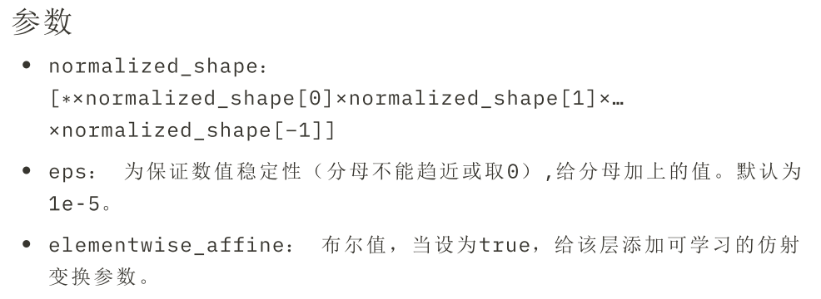
不依赖batchsize大小，RNN常用

Slide 52
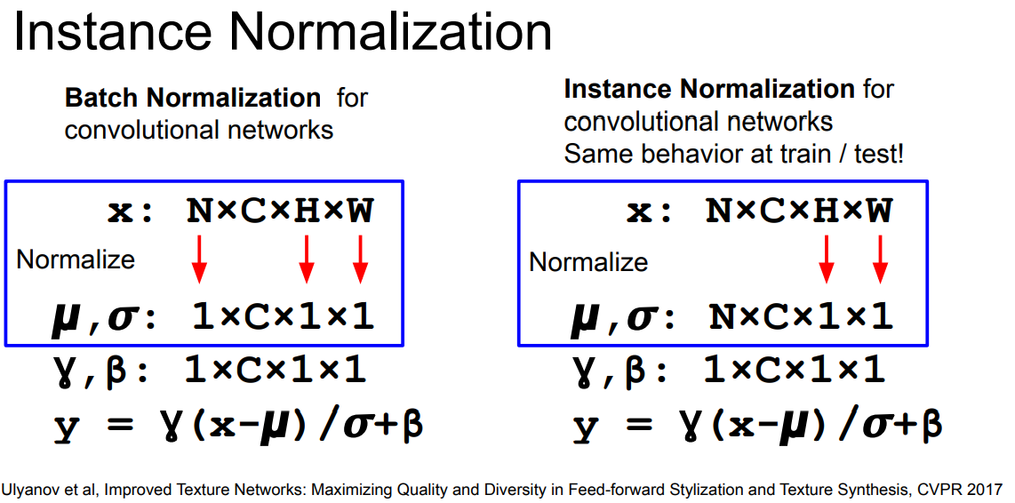
Normalization
主要用于单张图像处理（如：Gan 或 医学CT图像），相当于对数据进行归一化处理

Slide 53
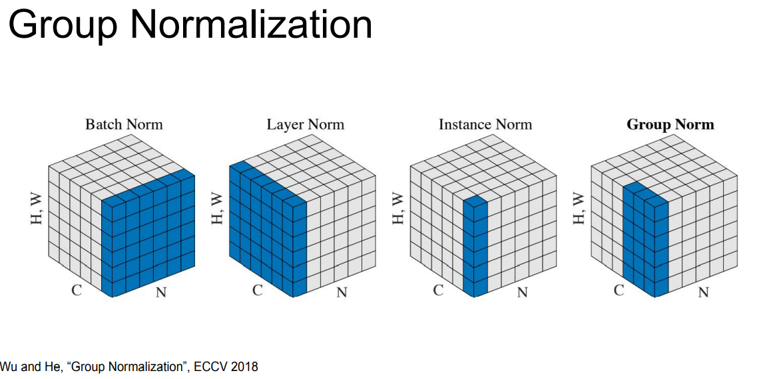
Normalization

Slide 54
Summary
Model Ensembles
Dropout
Dropconnect
Normalization
Regularization

Slide 55
“You need a lot of a data if you want to train/use CNNs”

Slide 56
Transfer Learning
“You need a lot of a data if you want to train/use CNNs”
NOT ALWAYS
Notes:
利用数据、任务、或模型之间的相似性，将在旧领域学习过的模型，应用于新领域的一种学习过程

Slide 57
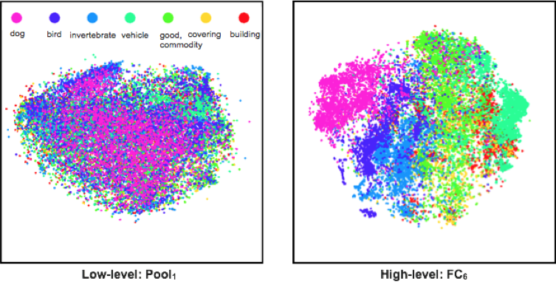
The Unreasonable Effectiveness of Deep Features
Classes separate in the deep representations and transfer to many tasks. [DeCAF] [Zeiler-Fergus]

Slide 58
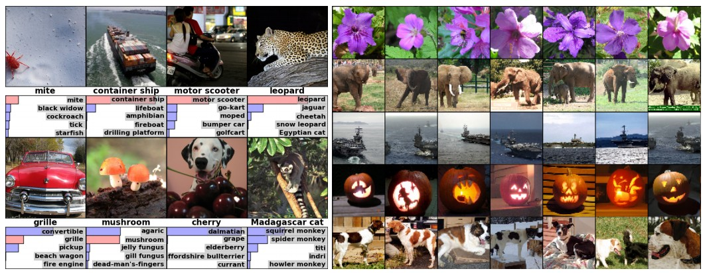
Can be used as a generic feature
(“CNN code” = 4096-D vector before classifier)
query image
nearest neighbors in the “code” space

Slide 59

Transfer Learning with CNNs
1. Train on
Imagenet

Slide 60
Transfer Learning with CNNs
1. Train on
Imagenet
2. If small dataset: fix all weights (treat CNN as fixed feature extractor), retrain only the classifier
i.e. swap the Softmax layer at the end
freeze
FC-C

Slide 61
Transfer Learning with CNNs
1. Train on
Imagenet
2. If small dataset: fix all weights (treat CNN as fixed feature extractor), retrain only the classifier
i.e. swap the Softmax layer at the end
3. If you have medium sized dataset(very similar), “finetune” instead: use the old weights as initialization, train the full network or only some of the higher layers
retrain bigger portion of the network, or even all of it.
freeze

Slide 62
Transfer Learning with CNNs
1. Train on
Imagenet
2. If small dataset: fix all weights (treat CNN as fixed feature extractor), retrain only the classifier
i.e. swap the Softmax layer at the end
3. If you have medium sized dataset(very different), “finetune” instead: use the old weights as initialization, train the full network or only some of the higher layers
retrain bigger portion of the network, or even all of it.
freeze
tip: use only ~1/10th of the original learning rate in finetuning to player, and ~1/100th on intermediate layers

Slide 63

Transfer Learning with CNNs
Ref. Rethinking ImageNet Pre-training

Slide 64






Slide 65
卷积网络工程实践技巧

Slide 66


Small filters

Slide 67
One conv with 5*5
two convs with 3*3
5*5*c*c=25c²
3*3*c*c*2=18c²
Notes:
一般停止在3*3

Slide 68


The power of 1*1 filters
Reduce dimension
Restore dimension
More nonlinearity
3*3*C*C=9C²
1*1*C*C/2+3*3*C/2*C/2+1*1*C/2*C
=3.25C²
Notes:
不能降维，但能够信息融合，减少参数量

Slide 69


任意nxn的卷积都可以通过1xn卷积后接nx1卷积来替代
注：在网络的前期使用这种分解效果并不好，还有在中度大小（对于mxm大小的feature map,建议m在12到20之间）的feature map上使用效果才会更好。

Slide 70



Slide 71

How to compute convolutions
Im2col
Turn convolution to matrix multiplication

Slide 72


im2col

Slide 73



Slide 74

单通道：

Slide 75





Slide 76


Slide 77


*

